Slide 1

Explainable AI-Driven Bone Tumor Detection Using Hybrid ResNet, EfficientNet, and ViT Models
Department of Computer Science and Engineering
First Review
Presented by:
Vidhya G
Madhumitha R
Shrimathi K
Shobana R
Date: 30/01/26
Guided By
Mrs. Bhuvanesawari R (A/P CSE)

Slide 2
CONTENT
Introduction
Project Title Justification
Summary of Literature
Identified Problem Statement
Problem Analysis
Objectives of the Project
Scope of the Project
Basic Concepts Related to the Project
Methodology – Flow Chart
Work progress up to 1st Review
Work to be done before 2nd Review

Slide 3
INTRODUCTION
Bone tumors are abnormal growths of bone tissue that can be either benign or malignant, requiring early and accurate diagnosis to improve patient survival rates. Manual analysis of medical images is time-consuming and highly dependent on radiologist expertise, which may lead to diagnostic inconsistencies. Recent advancements in Artificial Intelligence (AI), particularly Deep Learning, have shown promising results in automating medical image analysis. However, many existing models lack transparency and struggle to generalize across diverse datasets. This project introduces an Explainable AI-driven hybrid deep learning framework to enhance accuracy, interpretability, and reliability in bone tumor detection.

Slide 4
PROJECT TITLE JUSTIFICATION
The title “Explainable AI-Driven Bone Tumor Detection Using Hybrid ResNet, EfficientNet, and ViT Models” accurately reflects the core aspects of the project.
It emphasizes Explainable AI, highlighting transparency through visualization techniques like Grad-CAM.
The term Hybrid Models signifies the integration of CNN-based architectures (ResNet, EfficientNet) with Vision Transformers (ViT) for improved feature extraction.
Finally, Bone Tumor Detection clearly states the medical application domain, making the title precise, relevant, and research-oriented.

Slide 5
SUMMARY OF LITERATURE
S.No | Title | Author | Year | Findings (6 words)
1 | Bone Tumor Detection Using CNN | Zhang et al. | 2019 | CNN improves early tumor classification
2 | Medical Image Analysis with ResNet | He et al. | 2018 | Deep residual networks enhance accuracy
3 | EfficientNet for Medical Imaging | Tan & Le | 2020 | Efficient scaling improves performance
4 | Vision Transformers in Healthcare | Dosovitskiy et al. | 2021 | ViT captures global image context
5 | Explainable AI in Medical Diagnosis | Selvaraju et al. | 2020 | Grad-CAM improves model interpretability

Slide 6
IDENTIFIED PROBLEM STATEMENT
Existing bone tumor detection systems rely primarily on traditional CNN architectures and basic preprocessing methods, resulting in limited accuracy, poor generalization, and insufficient explainability, which restricts clinical trust and adoption.

Slide 7
PROBLEM ANALYSIS
CNN-only models focus mainly on local spatial features
Basic preprocessing techniques may miss subtle tumor boundaries
Lack of explainable outputs reduces doctor confidence
Lower accuracy limits real-world clinical usage
High dependency on manual interpretation still exists

Slide 8
OBJECTIVES OF THE PROJECT
To improve bone tumor detection accuracy using hybrid deep learning models
To integrate ResNet, EfficientNet, and Vision Transformers effectively
To enhance image quality using advanced preprocessing techniques
To provide explainable AI outputs using Grad-CAM visualization
To support reliable and interpretable clinical decision-making

Slide 9
SCOPE OF THE PROJECT
The project focuses on automated bone tumor detection from medical images using deep learning. It covers preprocessing, feature extraction, classification, and explainability. The system is intended as a decision-support tool for doctors and does not replace medical professionals. The scope is limited to image-based tumor detection and does not include treatment planning.

Slide 10
BASIC CONCEPTS RELATED TO THE PROJECT
Convolutional Neural Networks (CNN) – Feature extraction from images
Transfer Learning – Using pretrained deep models
ResNet & EfficientNet – Advanced CNN architectures
Vision Transformers (ViT) – Global contextual feature learning
CLAHE – Image contrast enhancement technique
Explainable AI (XAI) – Model transparency using Grad-CAM

Slide 11
GOOD HEALTH AND WELL-BEING
SDG 3, which focuses on ensuring healthy lives and promoting well-being for all, by improving medical diagnosis through advanced technology.

Slide 12
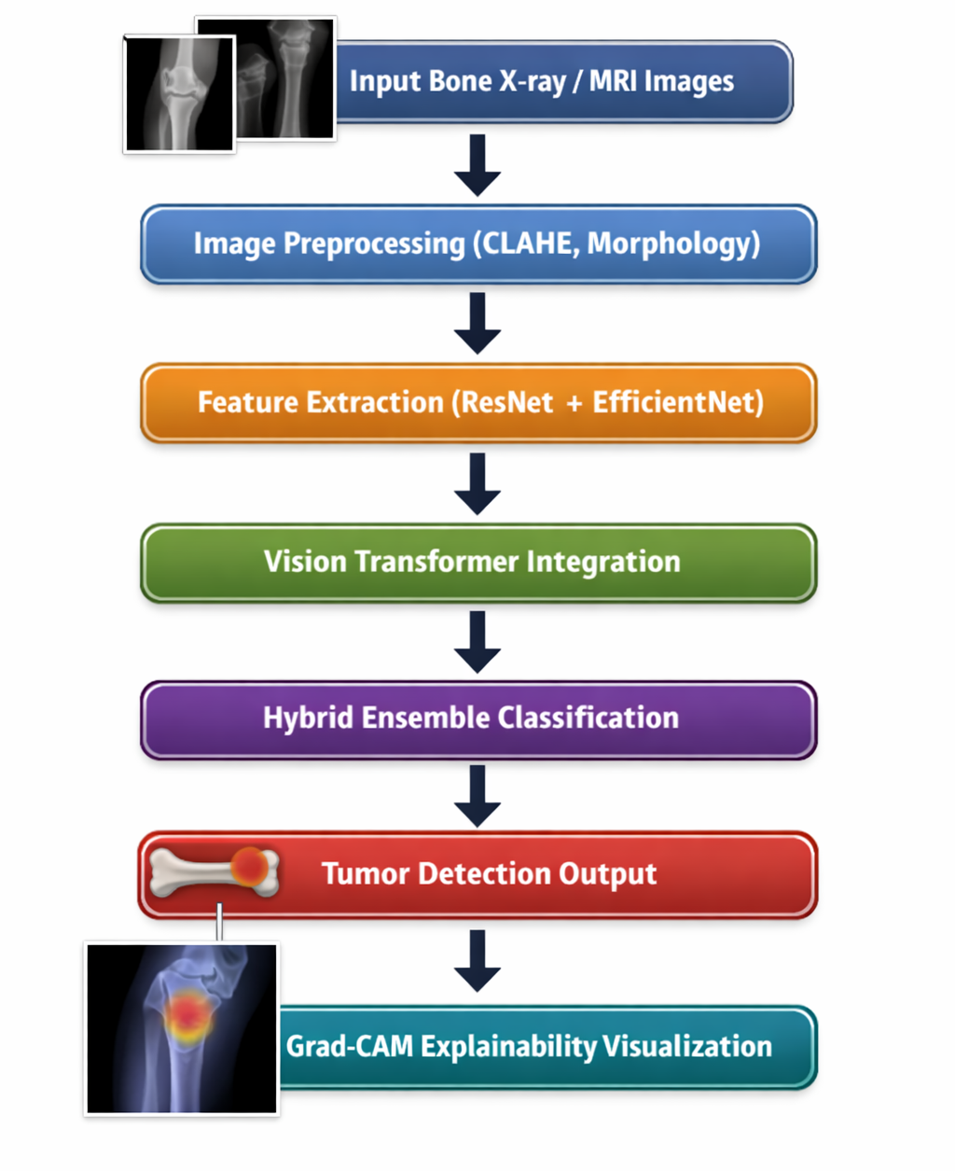
METHODOLOGY – FLOW CHART

Slide 13
WORK PROGRESS UP TO 1ST REVIEW
Problem identification → Identification of bone tumor misclassification issues in existing CNN-based medical imaging systems.
Literature survey → Detailed study of CNN, ResNet, EfficientNet, Vision Transformer, and Explainable AI approaches for bone tumor detection.
Dataset collection → Collection of publicly available bone X-ray / MRI image datasets for tumor classification.
Data preprocessing → Initial image preprocessing using resizing, normalization, and OTSU thresholding techniques.
Baseline model implementation → Development of a basic CNN model for bone tumor detection to establish baseline performance.
Performance analysis → Initial evaluation of baseline CNN model using accuracy, precision, recall, and F1-score metrics.

Slide 14
WORK TO BE DONE BEFORE 2ND REVIEW
Advanced preprocessing → Implementation of CLAHE and adaptive morphological operations to enhance tumor visibility.
Feature extraction → Extraction of deep features using hybrid ResNet-50 and EfficientNet architectures with transfer learning.
Transformer integration → Integration of Vision Transformer (ViT) to capture global contextual image features.
Hybrid model development → Development of an ensemble framework combining CNN-based models and ViT predictions.
Explainability integration → Implementation of Grad-CAM visualization for CNN models and attention maps for ViT-based interpretability.
Model optimization and evaluation → Hyperparameter tuning, cross-validation, and performance comparison with baseline CNN models.

Slide 15
THANK YOU

